Slide 1

IPC in Unix with Pipe and Fifo
Asist. Dr. Călin Alina Delia

Slide 2
Contents
Introduction in IPC
Pipe
Fifo
Best practices
Conclusions and Knowledge check

Slide 3

Introduction to Inter Process Communication (IPC)

Slide 4
Why?
A process is an instance of a program running in a computer.
Each process has its own allocated resources (memory, instructions, state, CPU)
If two programs (processes) are to communicate, we need special mechanisms: pipe, FIFO, shared memory, semaphores, socket, message queues, signals

Slide 5
What is a Pipe? What is a FIFO?
Pipe
FIFO
unidirectional flow of bytes between two processes: one writes bytes in the pipe/fifo, the other reads from it, in a first in first out order.
Anonymous (they have no name, they are virtual structures in the internal memory)
Only related processes can use pipes (egz. When using fork they duplicate the same file descriptors)
unidirectional flow of bytes between two processes: one writes bytes in the pipe/fifo, the other reads from it, in a first in first out order.
Named in the virtual file system (also called named pipe) to have a path entry
Can be used by independent processes as well as by related processes (by referring to their name/path in the file system)

Slide 6

Pipe
Unidirectional, mainly used among related processes.

Slide 7
C functions
Header file | #include <unistd.h>
Data types | int fd[2];
Create pipe | int pipe(int fd[2]); fd[0] is set up for reading, fd[1] is set up for writing returns 0 on success, 1 on failure and sets errno accordingly
Close pipe | int close(int fd); Each end of the pipe must be closed separately, in each process
Write in pipe | ssize_t write(int fd, const void *buf, size_t count);
Read from pipe | ssize_t read(int fd, void *buf, size_t count);

Slide 8

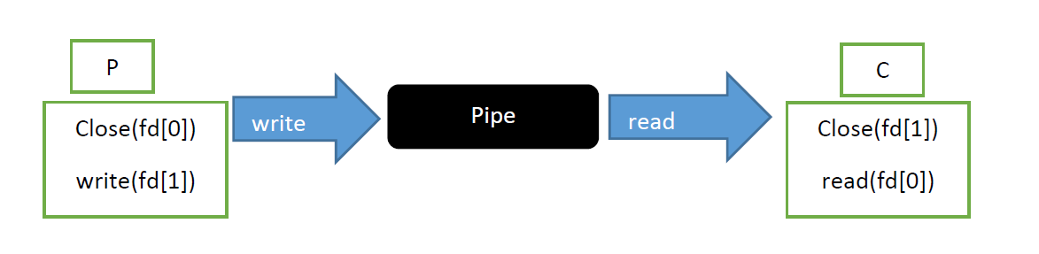

Usage
One pipe for each direction of communication
We close pipe ends not used (as soon as possible) for each process
Usually used between parent and child or two children of the same process (so they can duplicate ('inherit') the same file descriptor information obtained when using the pipe() call).
Pipe creation is before the fork() call.

Slide 9
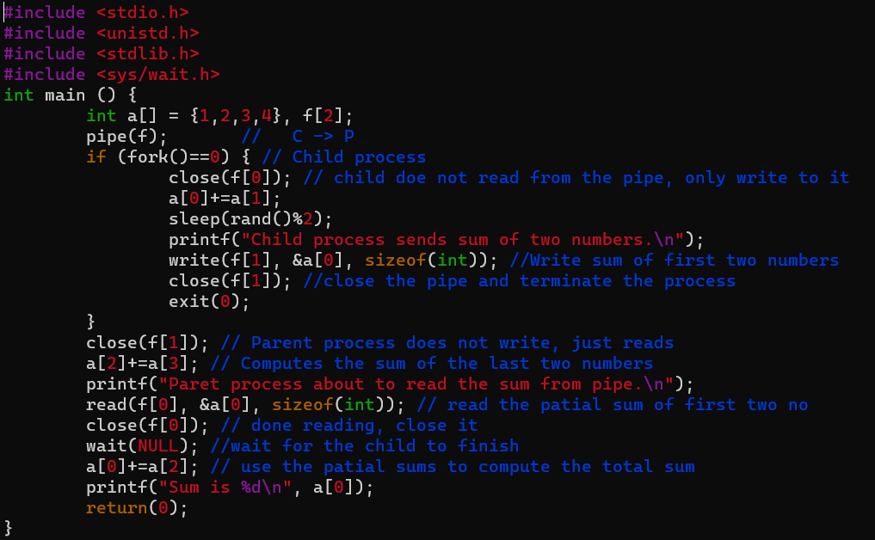
Example: Parallel addition
Adding four numbers in parallel. Child process adds first 2, parent last two and centralises the result.

Slide 10
popen
Popen opens a pipe and executes a fork which opens a shell. The child process executes the command. It has "r" and "w" modes:
- For “w” the calling process gets a file pointer to write in the pipe the standard input for the command, the fd[1] end of the pipe for writing, while the other end is duplicating the stdin or 0 (equivalent of dup2(fd[0], 0) )
- For “r” the calling process gets a file pointer to read from the pipe the standard output of the command, the fd[0] end of the pipe for reading, while the other end is redirecting the output of the command from stdout or 1 to the pipe (equivalent of dup2(fd[1], 1))
Uses fork() and dup2() C functions for implementation.

Slide 11
C functions
int fork() - duplicate the current process (named parent), new process called child. Returns 0 in the child, returns PID of the child in the parent, and –1 in case of error.
int dup2(int oldfd, int newfd); - duplicate the file descriptor, by copying oldfd value into newfd. Example: dup2 (p[1], 1); //Redirect standard output (1 or stdout) to a pipe p[1].

Slide 12
POPEN and PCLOSE: C functions
Header file | #include <stdio.h>
Create and open pipe, create child and open a shell to rum command | FILE *popen (const char *command, const char *type); |  | FILE* mypopen(char* cmd, char* type) { int p[2], caller_idx, child_idx; pipe(p); caller_idx = 0; if(type[0] == 'w') { caller_idx = 1; } child_idx = (caller_idx+1) % 2; if(fork() == 0) { close(p[caller_idx]); dup2(p[child_idx], child_idx); if(execlp("bash", "bash", "-c", cmd, NULL) < 0) { Close(p[child_idx]); exit(1); } } close(p[child_idx]); return fdopen(p[caller_idx], type); }
Close pipe and wait for child process | int pclose (FILE *stream); |  | void mypclose(FILE* fd) { fclose(fd); wait(0); }

Slide 13
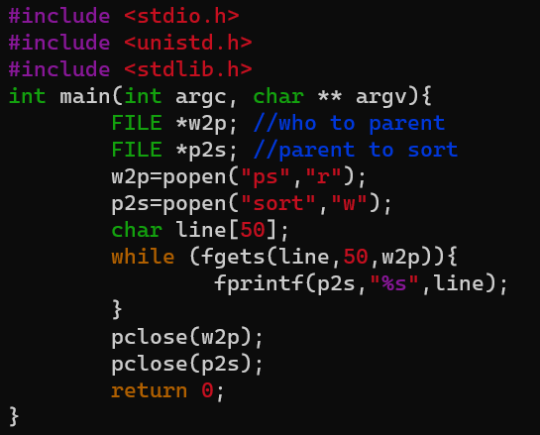
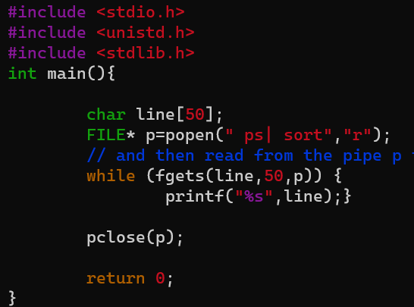
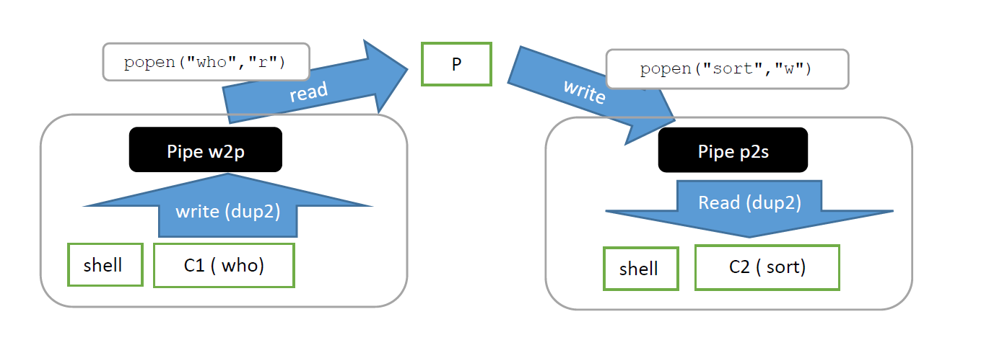
Example: who|sort
Write a program to execute the commands who |sort using two popen calls.
Using one open call.

Slide 14
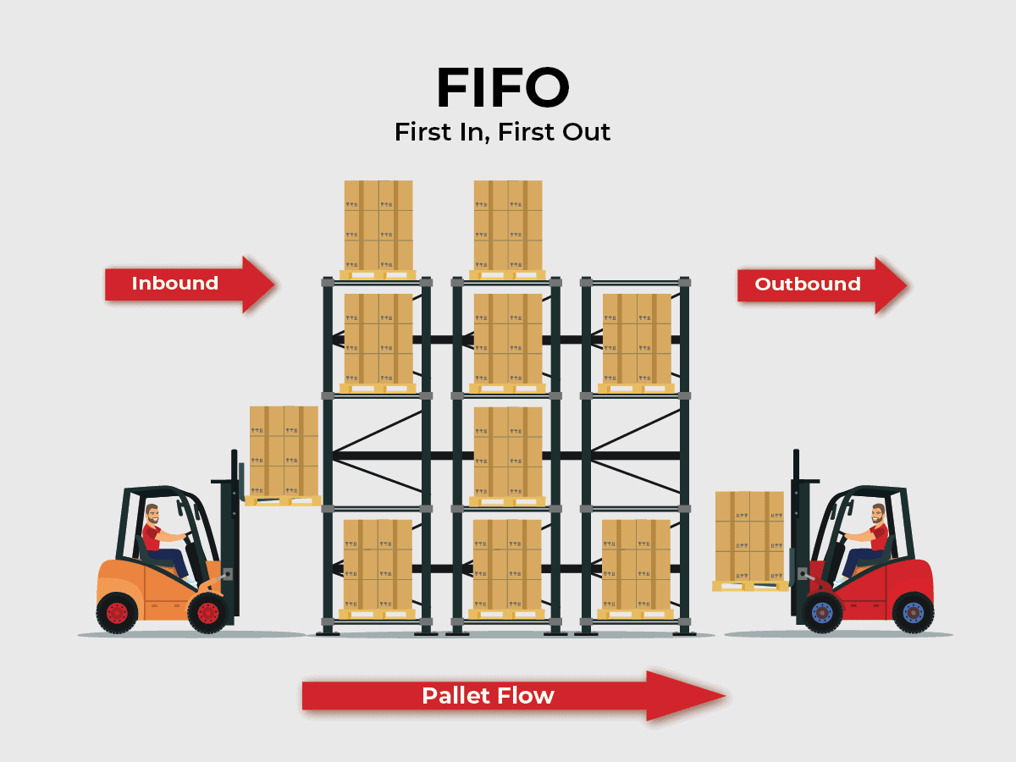
Fifo
Usage is the same as pipe (unidirectional) but can work with unrelated processes, as it exists in the file system.

Slide 15
C functions
Header file | #include <sys/types.h> #include <sys/stat.h> #include <fcntl.h> #include <unistd.h> /* for read, write, close, unlink */
Create fifo | int mkfifo(const char *pathname, mode_t mode); returns 0 on success, 1 on failure and sets errno accordingly Or use cmd line mkfifo fifo_path Or int mknod(const char *pathname, mode_t mode, dev_t dev);
Open fifo | int open(const char *pathname, int flags); Flags: O_RDONLY (open for reading), O_WRONLY (open for writing) return the new file descriptor, or -1 if an error occurred (in which case, errno is set appropriately) To return successfully the FIFO must be opened by the complementary operation by another process
Close fifo | int close(int fd); Each end of the pipe must be closed separately, in each process
Write in fifo | ssize_t write(int fd, const void *buf, size_t count);
Read from fifo | ssize_t read(int fd, void *buf, size_t count);
Destroy fifo | int unlink(const char *pathname); Or use cmd line rm fifo_path

Slide 16
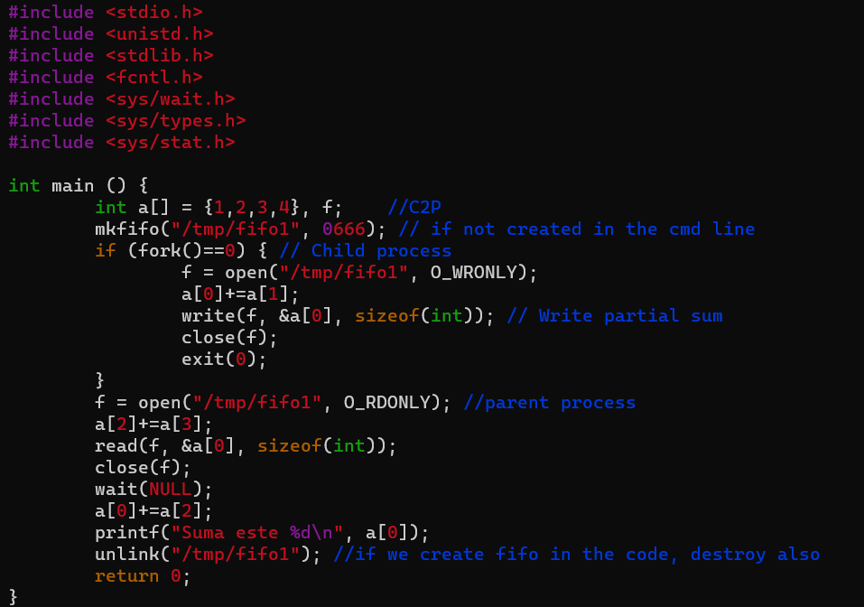
Example: Parallel addition
Adding four numbers in parallel. Child process adds first 2, parent last two and centralises the result.

Slide 17
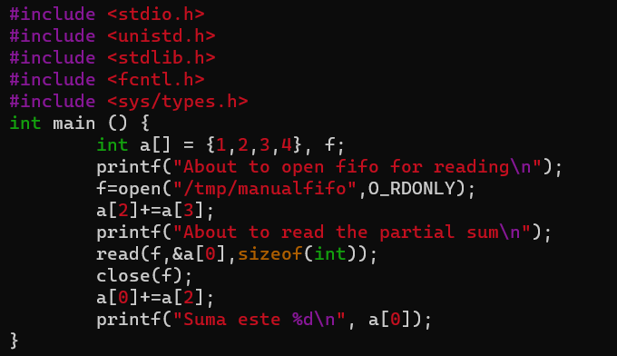
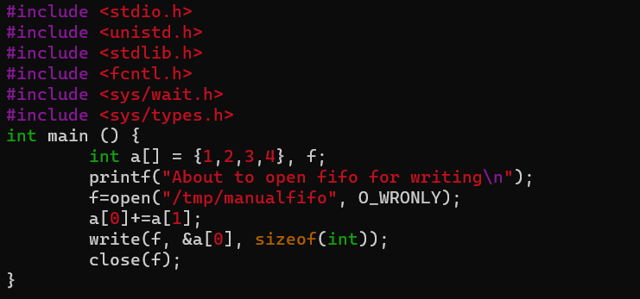
Example: Parallel addition
Adding four numbers in parallel. Use two separate processes.
In this example fifo is created and deleted in the cmd line:
mkfifo /tmp/manualfifo
or
mknod /tmp/manualfifo p
To delete: rm /tmp/manualfifo

Slide 18
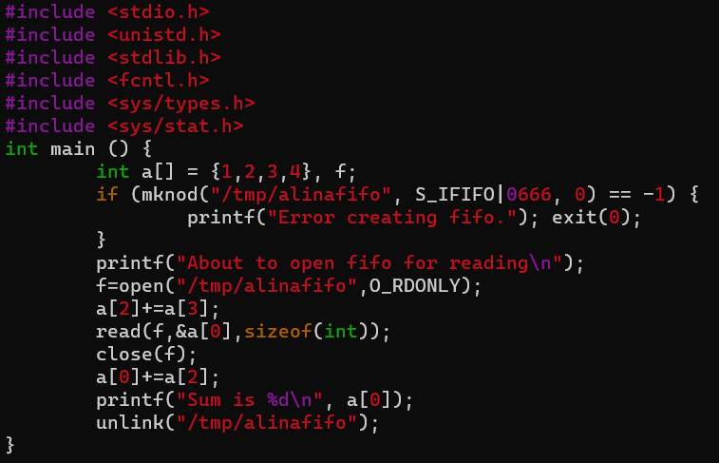
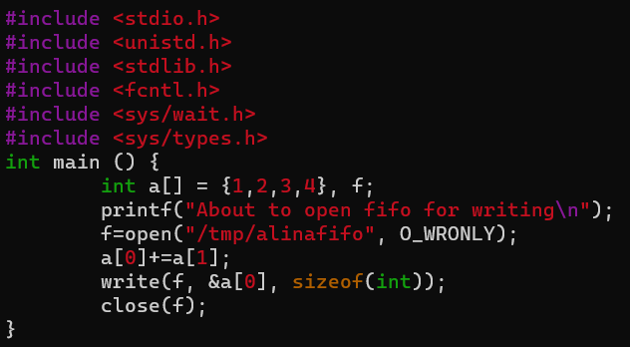
Example: Parallel addition
Same problem, two programs.
Using mknod C function to create the fifo.
Create fifo in folder /tmp if you get an error when creating it in another location

Slide 19

Best practices

Slide 20
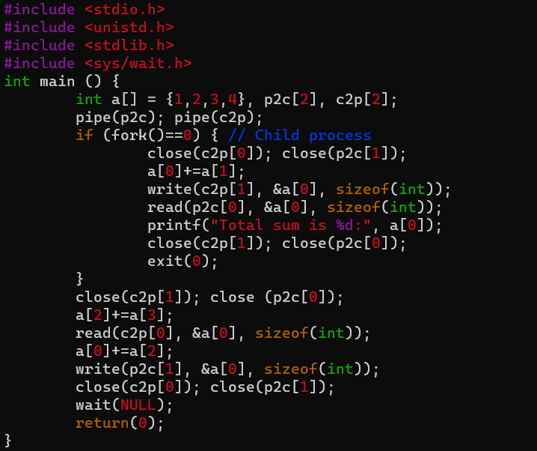
Example: Use separate pipes for each direction of communication
Adding four numbers in parallel. Child process adds first 2, parent last two and the result sent to child, who prints the result.
Close pipe end as soon as possible.

Slide 21
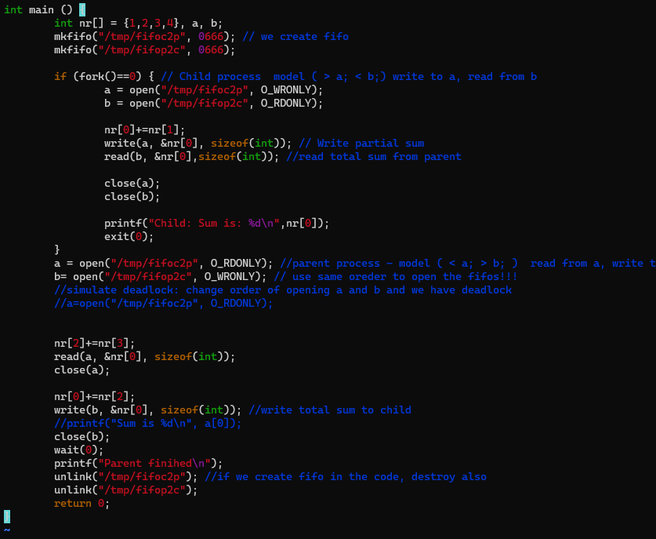
Example: Prevent FIFO Deadlock
Adding four numbers in parallel. Child process adds first 2, parent last two and the result sent to child, who prints the result.
Open fifos in the same order to prevent deadlock.

Slide 22
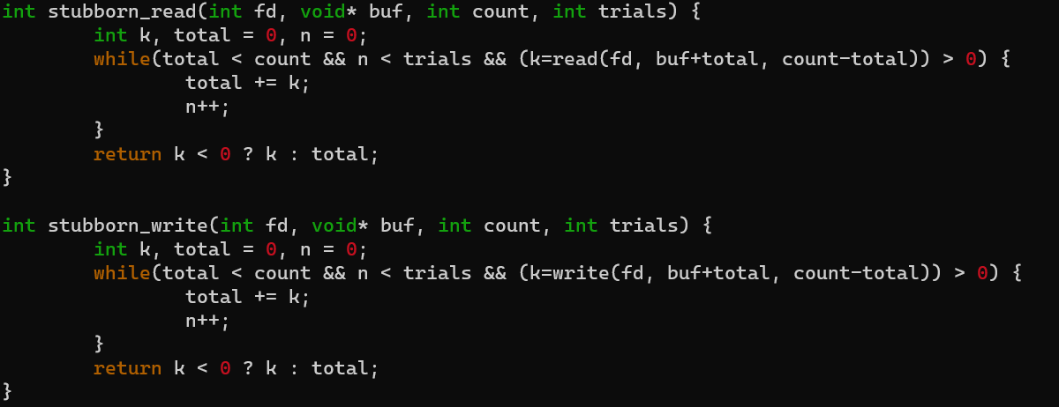
Example: Ensure write/read is complete
Both read and write will return the number of bytes they processed (i.e. read or written). If that number is less than expected, we can retry a number of times.

Slide 23

Knowledge check
Link to mentimeter

Slide 24
Additional resources
Man pages (sections 2, 3posix and 7):
https://man7.org/linux/man-pages/man7/pipe.7.html
https://man7.org/linux/man-pages/man7/fifo.7.html
Linux Kernel
https://www.kernel.org/doc/html/latest/filesystems/tmpfs.html#:~:text=Tmpfs%20is%20a%20file%20system,everything%20stored%20therein%20is%20lost.

Slide 25
Thank you!
Q&A

